Slide 1
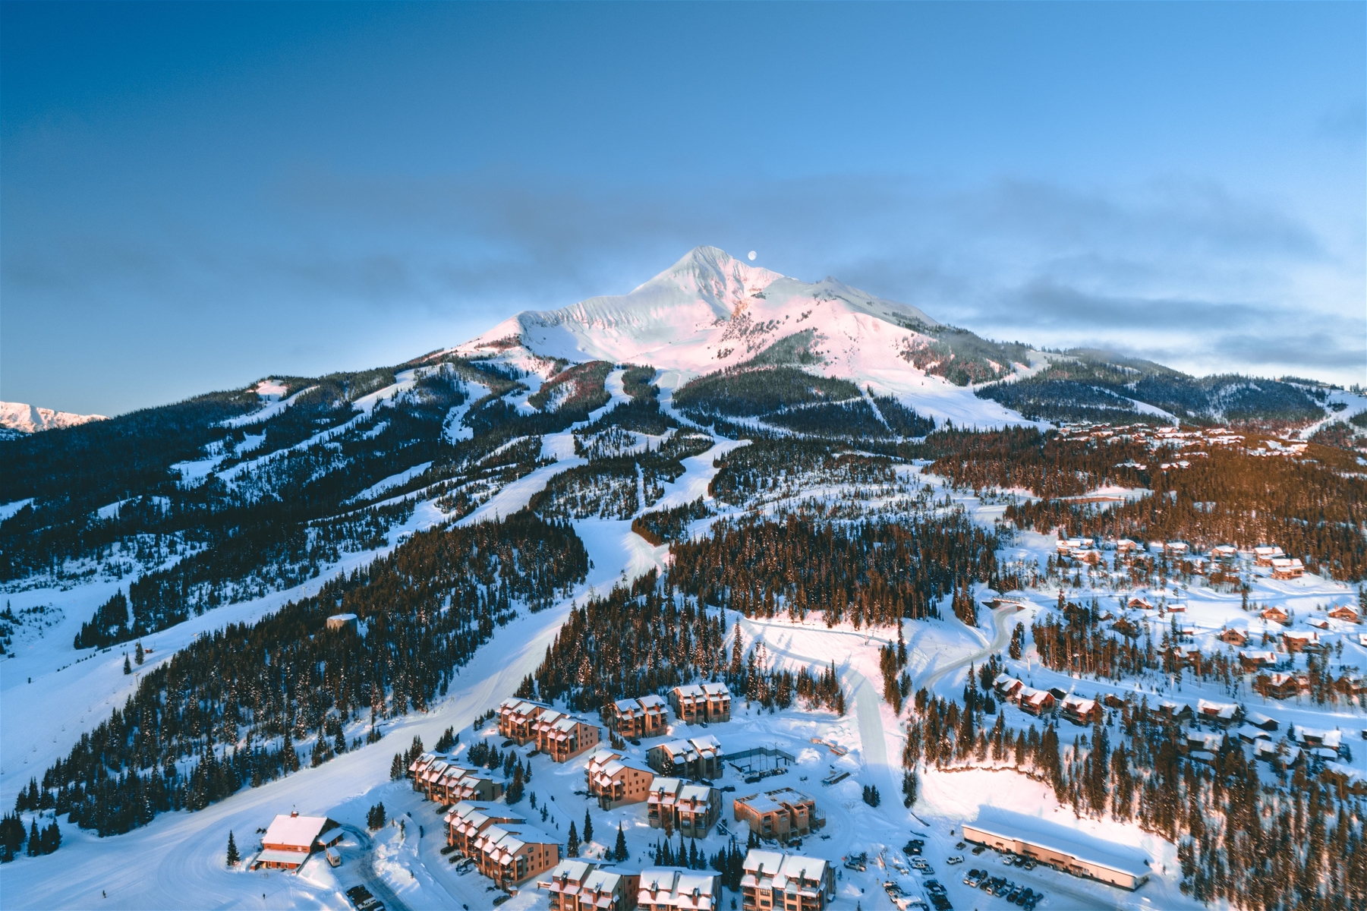
Big Mountain Resort
Executive Presentation

Slide 2
Problem Identification
Find opportunities for Big Mountain Resort to increase profit margins and offset the operational cost of $1,540,000 from the new lift by the start of FY25.

Slide 3
Recommendation & Key Findings
Scenario 2: Big Mountain will add an additional run, increase the vertical drop by 150 ft, and installing an additional chair lift.
This scenario will support an increase in ticket price by $1.99, and it will provide additional revenue of $3,747,638.

Slide 4
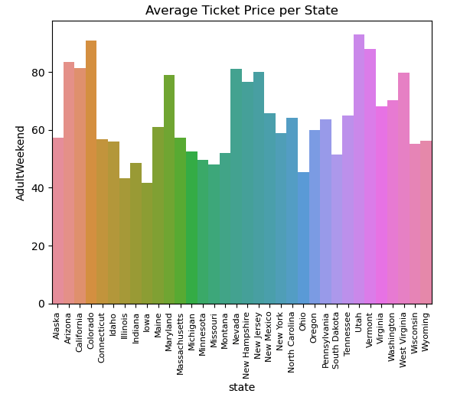
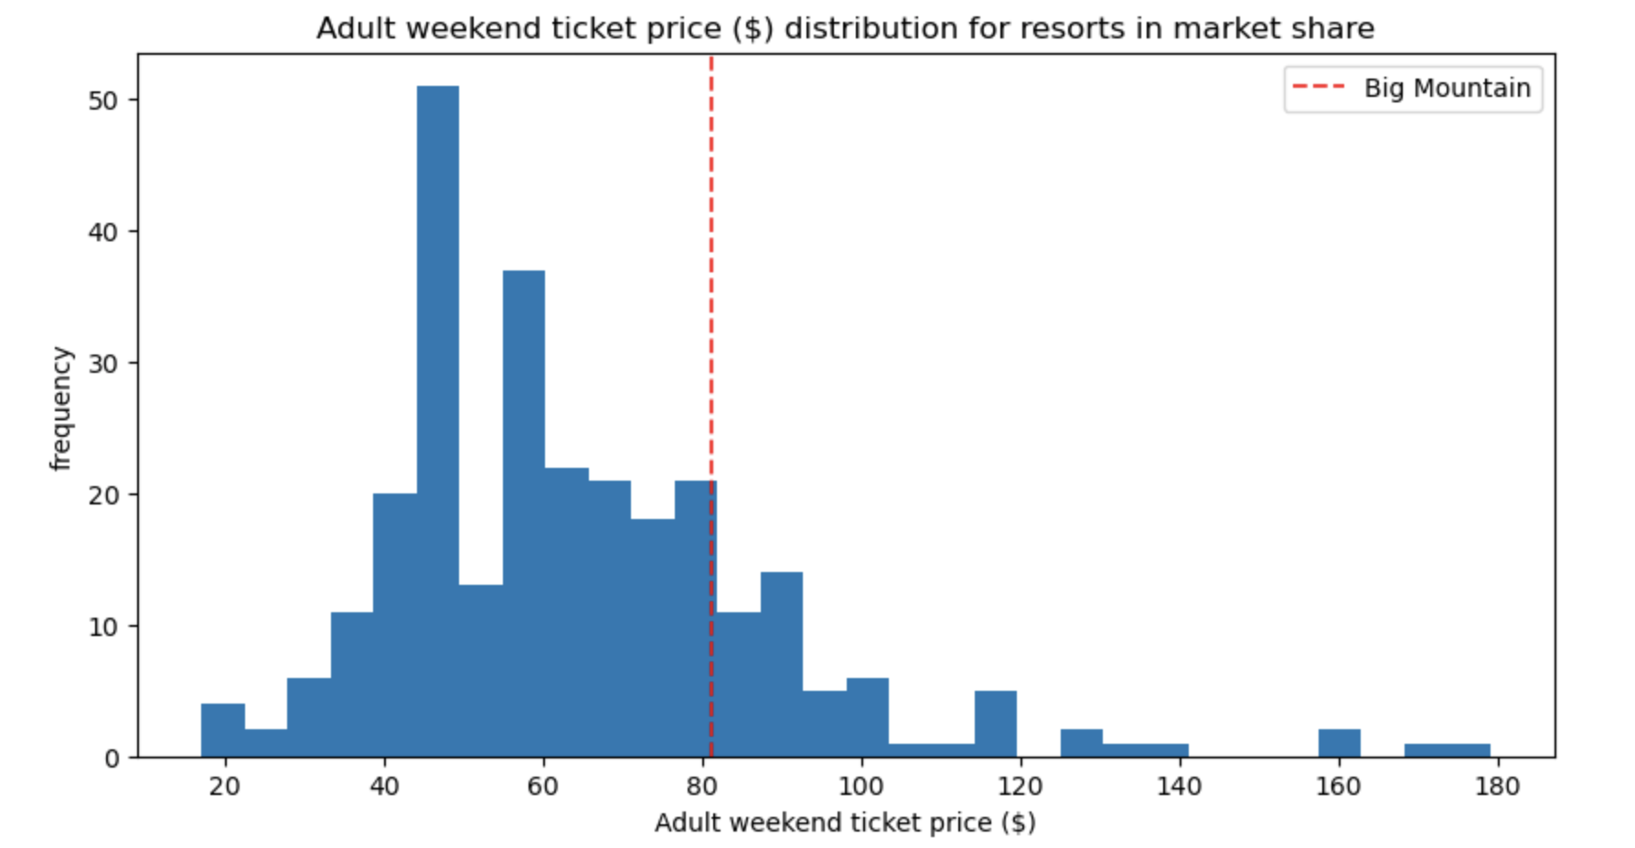
Modeling Results & Analysis
Figure 1 shows the distribution of average ticket prices by state. Montana has an average ticket price of roughly $50. Figure 2 depicts Big Sky’s ticket price compare to the rest of the resorts. Big Sky ticket price is $81. The majority of states have average ticket prices below $70, but an average ticket price of $80 is also fairly common.
figure 2
figure 1

Slide 5
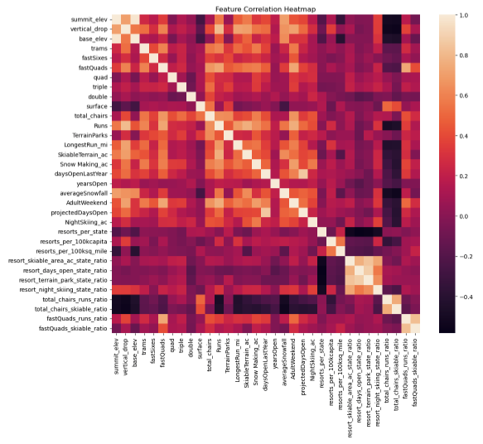
Modeling Results & Analysis
The heat map (figure 3) depicts the correlation between ski resort features. Number of runs and number of chairs both positively correlate to ticket price. Snow making area, vertical drop, and number of fast quads are also positively correlated to ticket price. I then measured the most important features in relation to ticket price. The most important features are fast quads, number of runs, snow making, and vertical drop.
figure 3

Slide 6
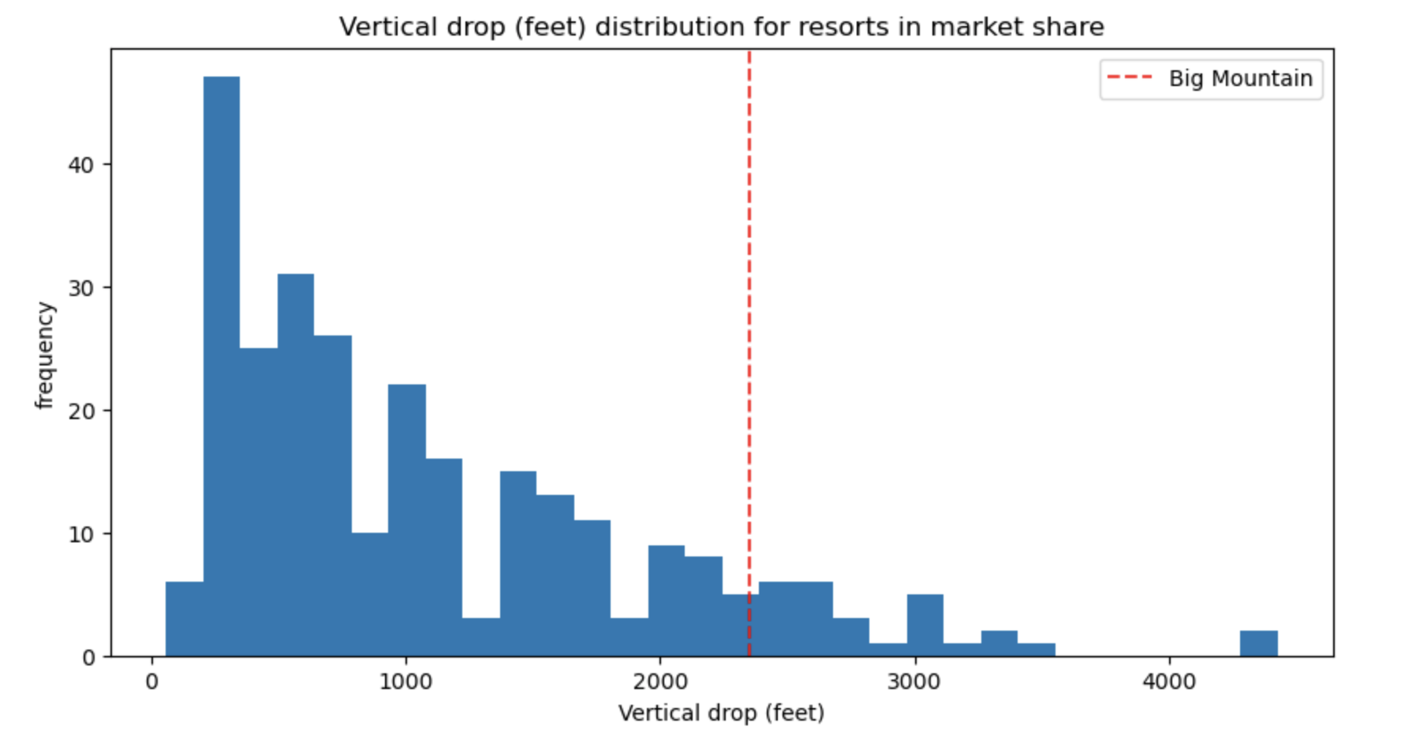
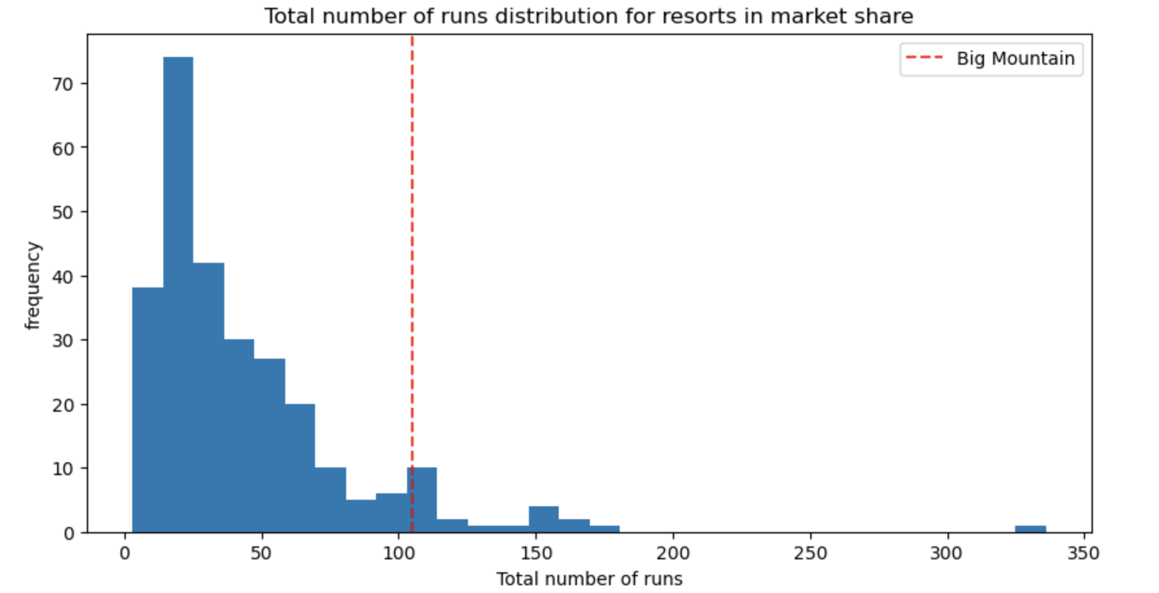
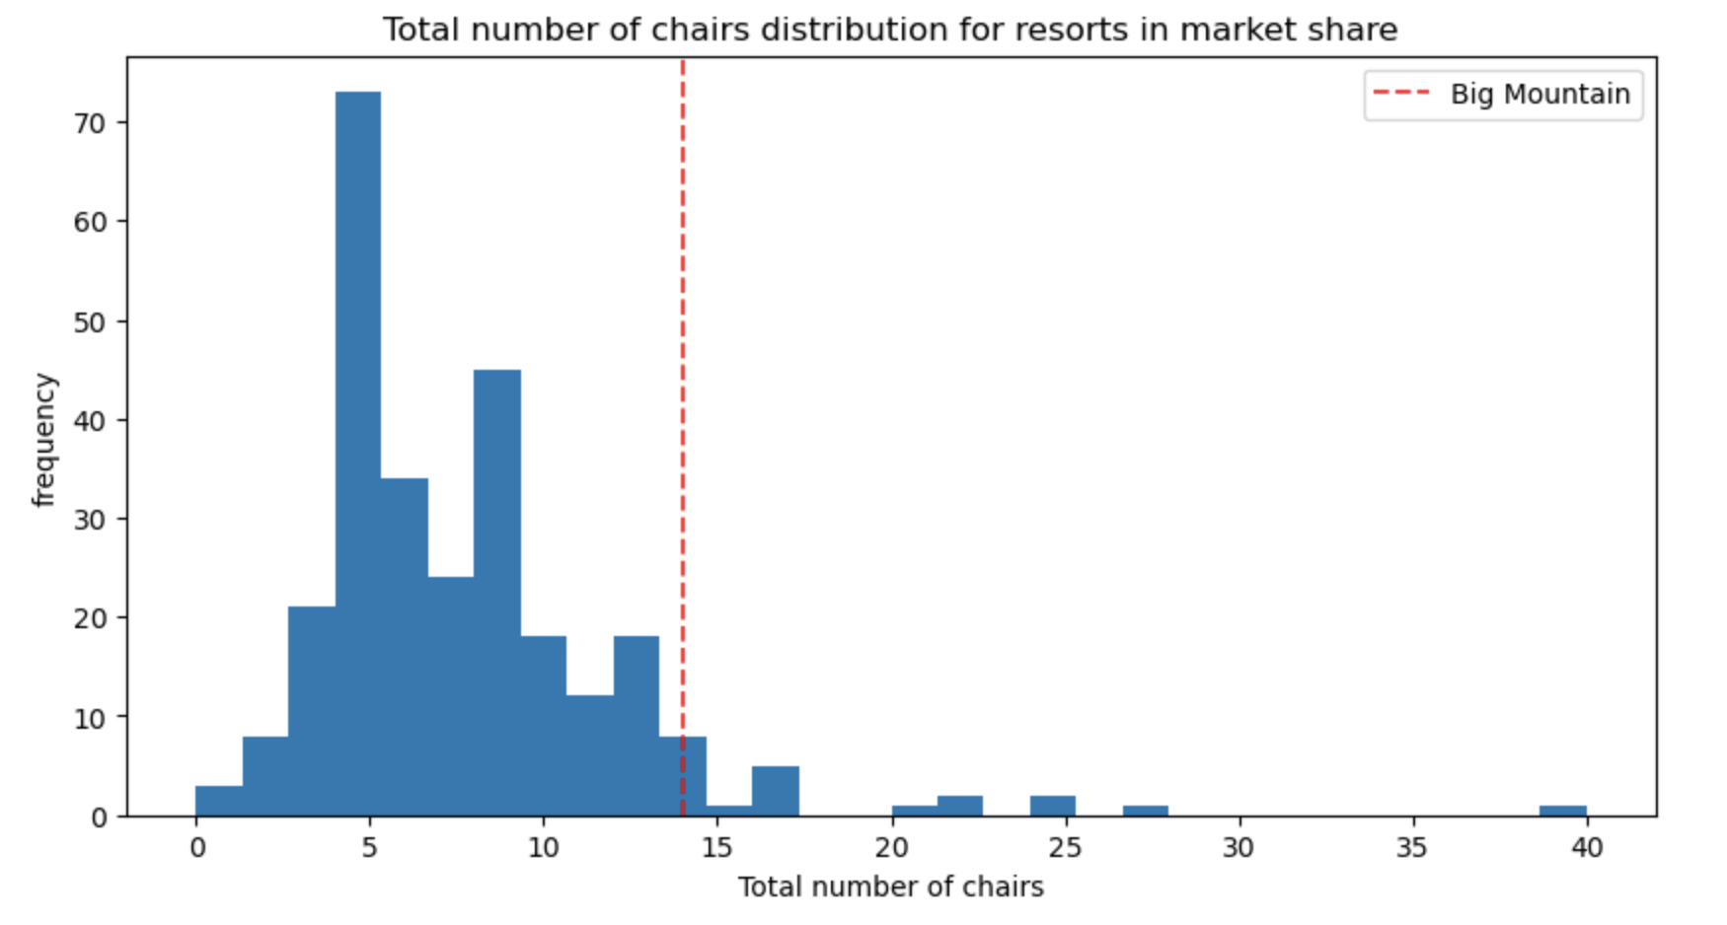
Modeling Results & Analysis
Further examining the features with the strongest positive correlation with ticket price, these graphs depict Big Mountain’s features in comparison to all other resorts. As seen in figures 4-6, Big Mountain exceeds its competitors in these features.
figure 4
figure 5
figure 6

Slide 7
Summary & Conclusion
Due to the strong positive correlation between vertical drop, number of runs, and number of chairs with ticket price, adding an additional run and ski lift as well as increasing vertical drop by 150 ft support an increase in ticket price of $1.99.
By raising ticket prices from $81 to $82.99, the additional operational cost of $1,540,000 will be covered by roughly 3711 people, assuming each person buys five tickets. Big Mountain predicts roughly 340,000 people will visit the resort this year for about five days, so the expected revenue from ticket sales will be about $141,083,000.

